Slide 1
OTP GENERATION
PIP104 University Project-II
Final review
Batch Number:IST-G06
Roll Number | Student Name
20201ISI0027 20201IST0001 20201IST0053 20201IST0054 | HUMERA HR JEEVITHA SUFIYA TANZEEN RESHMA BAI S
Under the Supervision of,
Ms. PUSHPALATHA.M
Assistant Professor
School of Computer Science & Engineering
Presidency University

Slide 2
Introduction
In the dynamic landscape of modern workplaces, where technology plays an integral role in optimizing efficiency, the significance of a secure and user-friendly staff portal cannot be overstated. Enter the "Secure Staff Portal," a robust platform meticulously designed to provide staff members with a seamless and secure experience in managing their accounts. In this era of digital connectivity, where organizations strive for streamlined operations, our portal stands as a beacon of efficiency, combining a straightforward login process with a cutting-edge One-Time Password (OTP) recovery system.
1.The Evolving Work Environment:
As organizations continue to adapt to evolving work paradigms, the need for a centralized and accessible staff portal becomes paramount. In such an environment, ensuring that staff members can effortlessly access their accounts, irrespective of their physical location, becomes a critical aspect of organizational efficiency.
2. The Promise of Seamless Access:
The "Secure Staff Portal" emerges as a solution attuned to the demands of the contemporary workplace. At its core lies a login process that is as simple as it is secure. Our portal requires nothing more than a username and password for swift entry. It forms the foundation for a user experience that prioritizes both convenience and safeguarding sensitive information.

Slide 3
3. A Closer Look at the Login Process:
Picture this: A staff member, whether at their desk or working remotely, needs to access their account. With the "Secure Staff Portal," they enter their designated username and password – a straightforward yet secure gateway to their workspace. It ensures that accessing essential information is not a hurdle but a swift and uncomplicated task.
4. Beyond Forgotten Credentials: The OTP Recovery System:
However, recognizing the inevitability of forgotten login credentials, the "Secure Staff Portal" introduces a user-friendly "Generate OTP" feature. In the event of memory lapses or password resets, this feature acts as a reliable safety net. A One-Time Password (OTP) is promptly dispatched to the user's registered email address, establishing an additional layer of security. This approach not only facilitates easy recovery but also ensures that the process aligns with the highest standards of data protection.

Slide 4
Literature Review
[1]The Impact of Artificial Intelligence in Healthcare: A Comprehensive Literature Review
This literature review paper explores the extensive impact of artificial intelligence (AI) in the healthcare sector. It examines the various applications, challenges, and opportunities AI presents, shedding light on its potential to revolutionize patient care and diagnosis
[2]Blockchain Technology: A Comprehensive Survey and Future Directions
This comprehensive survey delves into the world of blockchain technology, providing insights into its development, use cases, and potential future directions. The paper highlights the security and transparency advantages that blockchain offers across various industries.
[3]Climate Change and Global Agriculture: A Synthesis of Recent Literature
This synthesis of recent literature reviews the impact of climate change on global agriculture. It analyzes the challenges faced by farmers, potential solutions, and policy recommendations to address the evolving climate-related issues in agriculture.
[4]The Psychology of Online Social Networks: A Critical Review
This paper critically reviews the psychological aspects of online social networks. It examines how social media platforms impact human behavior, relationships, and mental health, shedding light on both positive and negative consequences.
[5]Renewable Energy Sources: A Comprehensive Overview of Recent Advances
This comprehensive overview explores recent advances in renewable energy sources, focusing on solar, wind, and hydropower technologies. It discusses innovations in energy generation and storage, aiming to contribute to a more sustainable future.

Slide 5
[6]Big Data Analytics in Marketing: A Systematic Literature Review
This systematic literature review examines the application of big data analytics in marketing. It outlines the methodologies, tools, and key findings used in marketing research to harness the power of big data.
[7]The Role of Microbiota in Human Health: An In-depth Analysis
This in-depth analysis delves into the crucial role of the human microbiota in maintaining health. It discusses the symbiotic relationship between the human body and its microbial inhabitants and its implications for overall well-being.
[8]Chronic Pain Management: A Comprehensive Review of Interventions
This comprehensive review explores interventions and strategies for managing chronic pain. It covers both pharmaceutical and non-pharmaceutical approaches, providing a valuable resource for healthcare professionals and patients.
[9]Urbanization and Its Impact on Biodiversity: A Global Perspective
This global perspective literature review examines the impact of urbanization on biodiversity. It addresses the ecological consequences of urban expansion and provides insights into strategies for urban planning that can help mitigate its effects on the environment.
[10]The Evolution of E-Learning: A Review of the Last Decade"
This paper reviews the evolution of e-learning over the past decade, exploring emerging technologies, pedagogical methods, and the impact of e-learning on education. It provides an overview of the advancements that have shaped the landscape of online education.

Slide 6
Proposed Method
The "Secure Staff Portal" is a cutting-edge solution engineered to redefine staff management in the digital age. Anchored in the recognition of the limitations of traditional staff portals, our proposed method leverages state-of-the-art technologies and innovative design principles to create a platform that seamlessly integrates convenience, security, and adaptability.
1. Intuitive and Secure Login Process:
The proposed method introduces a login process that marries simplicity with robust security. Staff members can gain access to the portal by entering their designated username and password, ensuring a quick and straightforward authentication experience. To fortify security, password policies are enforced, encouraging the creation of strong and unique passwords. The system employs advanced encryption techniques to safeguard user credentials during transmission and storage.
2. One-Time Password (OTP) Recovery System:
Addressing the perennial challenge of forgotten login credentials, the "Secure Staff Portal" incorporates an efficient One-Time Password (OTP) recovery system. Users can initiate the recovery process by selecting the "Generate OTP" feature, which promptly sends a secure OTP to their registered email address. This extra layer of security not only aids in account recovery but also adds resilience against unauthorized access attempts.
3. Multi-Factor Authentication (MFA):
Enhancing the security posture of the portal, multi-factor authentication (MFA) is integrated. Staff members have the option to enable additional authentication factors such as Mail-Based Verification. This multi-layered approach adds an extra level of defense against unauthorized access, aligning with industry best practices for securing sensitive information.
4. Cross-Device Compatibility and Accessibility:
The proposed method prioritizes accessibility by ensuring the portal is compatible across various devices and browsers. Staff members can seamlessly transition between desktop computers, laptops, tablets, and smartphones without compromising the user experience. This flexibility caters to the diverse work environments of the modern workforce, including those who engage in remote or on-the-go work.

Slide 7
5. Modern and Intuitive User Interface:
Recognizing the importance of user experience, the portal boasts a modern and intuitive user interface. Streamlined navigation, clear design elements, and user-friendly interactions contribute to a positive and efficient experience. The interface is designed to minimize the learning curve for new users while providing a visually appealing and engaging platform for managing accounts.
6. Scalable Architecture:
To accommodate the evolving needs of organizations, the proposed method is built on a scalable architecture. The portal is designed to seamlessly scale as user volumes increase, ensuring consistent performance and responsiveness. This scalability feature positions the "Secure Staff Portal" as a future-proof solution capable of adapting to the growth trajectories of diverse organizations.
7. Compliance-Centric Design:
Compliance with data protection regulations is a non-negotiable aspect of the proposed method. The system is engineered with robust compliance measures, ensuring adherence to the latest privacy standards and regulations. Regular assessments and updates are conducted to keep pace with evolving compliance requirements, mitigating legal and reputational risks for organizations using the portal.
8. Continuous Improvement Through Feedback Integration:
A vital component of the proposed method involves the integration of feedback mechanisms. Users are encouraged to provide insights and suggestions, creating a dynamic feedback loop that informs continuous improvements. This user-centric approach allows the "Secure Staff Portal" to evolve in response to emerging user needs, technological advancements, and evolving security challenges.

Slide 8
Objectives
In the development and implementation of the "Secure Staff Portal," a comprehensive set of objectives has been meticulously outlined, aligning with the overarching goals of enhancing user experience, fortifying security measures, and contributing to the overall efficiency of staff management within organizations.
1. Seamless User Experience:
The primary objective of the "Secure Staff Portal" is to deliver a seamless and intuitive user experience. The login process, requiring only a username and password, aims to eliminate barriers to entry, ensuring that staff members can access their accounts with minimal effort. This objective encompasses a commitment to user-centric design, acknowledging the importance of simplicity in the navigation and interaction within the portal.
2. Efficient Account Management:
The portal seeks to redefine the landscape of account management for staff members. Through a clear and concise interface, users should be able to navigate effortlessly, update information, and manage their accounts with minimal learning curve. The efficiency in account management contributes directly to increased productivity and a reduction in administrative overhead, aligning with the modern organizational ethos of streamlined operations.
3. Robust Security Measures:
Security is a paramount concern, and the "Secure Staff Portal" is dedicated to implementing robust measures to safeguard sensitive information. The introduction of a One-Time Password (OTP) recovery system adds an additional layer of security, ensuring that even in the event of forgotten credentials, access to accounts remains secure. This objective addresses the ever-growing need for stringent data protection measures in an era where cybersecurity threats loom large.

Slide 9
4. Accessibility Across Devices:
Recognizing the diversity in work environments and the prevalence of remote work, the portal aims to be accessible across various devices. Whether accessed from a desktop computer, laptop, tablet, or smartphone, the "Secure Staff Portal" intends to offer a consistent and optimized user experience. This objective reflects a commitment to adaptability and inclusivity, catering to the evolving needs of a workforce that values flexibility and mobility.
5. User-Friendly OTP Recovery:
The OTP recovery system, a critical feature of the portal, is designed with the user in mind. The objective is to provide a straightforward process for generating and receiving One-Time Passwords, ensuring that staff members can recover access to their accounts promptly and without unnecessary complications. This user-friendly approach enhances the overall resilience of the portal, contributing to a positive user experience even in challenging scenarios.
6. Scalability and Adaptability:
The "Secure Staff Portal" is built with scalability and adaptability at its core. As organizations grow and evolve, the portal should seamlessly accommodate an increasing number of users and adapt to changing technological landscapes. This objective ensures that the portal remains a reliable and future-proof solution, capable of meeting the dynamic needs of organizations across various industries.
7. Feedback Integration and Continuous Improvement:
The development and implementation of the portal mark the beginning of an iterative process. Regular feedback mechanisms are established to gather insights from users, allowing for continuous improvement. The objective is to create a dynamic portal that evolves in response to user needs, technological advancements, and emerging security challenges.

Slide 10
Methodology
The technical approach to implementing the HRMS includes:
- Utilizing Python for backend development.
- Employing Django and Flask frameworks to build the web application.
- Designing an intuitive user interface using HTML and CSS.
- Implementing OTP generation and delivery through email services.
This section provides insights into the actual development process, including:
- Code snippets or modules for user authentication and role management.
- Screenshots or diagrams showcasing the web app's user interface.
- Description of how OTPs are generated and sent to users' Gmail accounts.

Slide 11
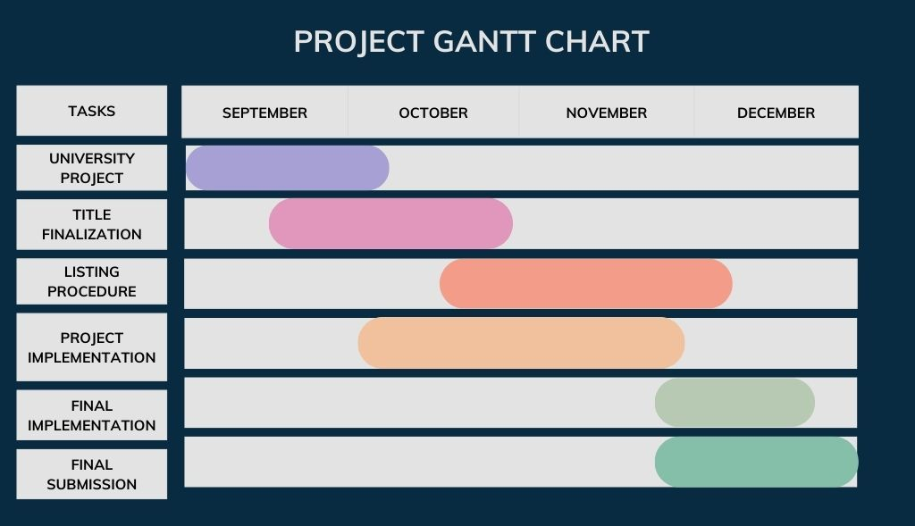
Timeline of Project

Slide 12
Expected Outcomes
The "Hospital Record Management with OTP Generation for Staff Login" project addresses a critical need for secure and cost-effective access management in a healthcare setting. The implementation of OTPs as an alternative login method is a sound security practice. However, to enhance the project's effectiveness, consider the suggested improvements and continue to prioritize security, user-friendliness, and scalability as key aspects of development and deployment.

Slide 13
Conclusion
The objectives of the "Secure Staff Portal" converge on creating a holistic solution that harmonizes user experience, security, and adaptability. By prioritizing these key elements, the portal aspires to redefine how organizations manage their staff, fostering a digital environment that is both efficient and secure.
The traditional staff portal landscape was characterized by its reliance on outdated authentication methods, limited security features, and inadequate adaptability to the evolving needs of a dynamic workforce. Recognizing the shortcomings of these systems laid the foundation for the conceptualization and development of the "Secure Staff Portal" to address these challenges and usher in a new era of efficient, secure, and user-friendly staff management solutions.
The proposed method encapsulates a holistic approach to staff management, addressing the shortcomings of traditional systems while introducing innovative features to enhance security, accessibility, and user experience. The "Secure Staff Portal" stands as a testament to our commitment to ushering in a new era of efficient, secure, and user-centric staff management solutions.

Slide 14
References
1. Uymatiao, Mariano Luis T., and William Emmanuel S. Yu. "Time-based OTP authentication via secure tunnel (TOAST): A mobile TOTP scheme using TLS seed exchange and encrypted offline keystore." In 2014 4th IEEE International Conference on Information Science and Technology, pp. 225-229. IEEE, 2014.
2. Swedha, K., and Tanuja Dubey. "Analysis of web authentication methods using Amazon web services." In 2018 9th International Conference on Computing, Communication and Networking Technologies (ICCCNT), pp. 1-6. IEEE, 2018.
3. Basavala, Sreenivasa Rao, Narendra Kumar, and Alok Agarrwal. "Authentication: An overview, its types and integration with web and mobile applications." In 2012 2nd IEEE International Conference on Parallel, Distributed and Grid Computing, pp. 398-401. IEEE, 2012.
4.Wang, Huping, Chunxiao Fan, Shuai Yang, Junwei Zou, and Xiaoying Zhang. "A new secure OpenID authentication mechanism using one-time password (OTP)." In 2011 7th International Conference on Wireless Communications, Networking and Mobile Computing, pp. 1-4. IEEE, 2011.
5.Parmar, Viral, Harshal A. Sanghvi, Riki H. Patel, and Abhijit S. Pandya. "A comprehensive study on passwordless authentication." In 2022 International Conference on Sustainable Computing and Data Communication Systems (ICSCDS), pp. 1266-1275. IEEE, 2022.
6.Yi Chen, Hong Wen, Huanhuan Song, Songlin Chen, Feiyi Xie, Qing Yang and Lin Hu
Journal: IET Communications, 2018, Volume 12, Number 12, Page 1477
7.Paterson, Kenneth G., and Douglas Stebila. "One-time-password-authenticated key exchange." In Information Security and Privacy: 15th Australasian Conference, ACISP 2010, Sydney, Australia, July 5-7, 2010. Proceedings 15, pp. 264-281. Springer Berlin Heidelberg, 2010.
8.Gupta, Niharika, and Rama Rani. "Implementing high grade security in cloud application using multifactor authentication and cryptography." International Journal of Web & Semantic Technology 6, no. 2 (2015): 9.
9.Kaur, Navpreet, Mandeep Devgan, and Shashi Bhushan. "Robust login authentication using time-based OTP through secure tunnel." In 2016 3rd International Conference on Computing for Sustainable Global Development (INDIACom), pp. 3222-3226. IEEE, 2016.
10.Liou, Jing-Chiou, and Sujith Bhashyam. "A feasible and cost effective two-factor authentication for online transactions." In The 2nd International Conference on Software Engineering and Data Mining, pp. 47-51. IEEE, 2010.

Slide 15
Thank You

